Slide 1
GeoSyncra
Team07
Gokulnaath Govindaraj
Jenessa Sparks
Anna Crafton
Prabesh Bhattarai

Slide 2
Elevator Pitch
GeoSyncra will help people connect with others by allowing them to navigate easily. Small landmarks are common but often lack a name or address. Such locations can be difficult to find using other navigation technologies. Our project will solve this problem by using an image search to provide directions to user-submitted locations. These directions can be sent to friends so people can find each other quickly.This solution offers a streamlined, interactive way to manage memories and tasks tied to physical locations, improving productivity and user experience.

Slide 3
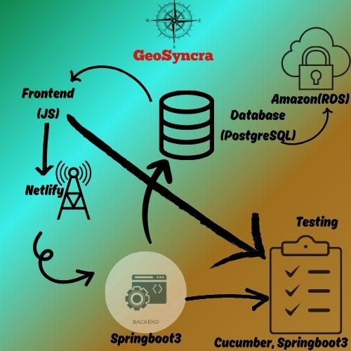
Overview
Frontend Development
Backend Development
Database Management
Testing
Deployment
Conclusion

Slide 4
Topics we Cover
Anna will cover the implementation of Frontend part of GeoSyncra
Janessa will cover the database creation part of GeoSyncra
Gokulnaath will talk about how the website is deployed online.
Backend
Testing
Frontend
Database
Deployment
Gokulnaath will cover the Backend Part of GeoSyncra
Prabesh will explain the testing plan and how the testing is executed.

Slide 5
Frontend Development
Anna Crafton
Each component of complexity needs intro of one user story, 1 requirement, 1 design thing, and then implementation (gif, figure, or screenshot of code), conclusion.

Slide 6
User Story
“As a user, I want to upload the picture of difficult-to-find places wherever I go and can share with my friends so that it will be easier for them to find.”
Requirement
“The system shall allow users to upload images along with location details (latitude and longitude).”

Slide 7
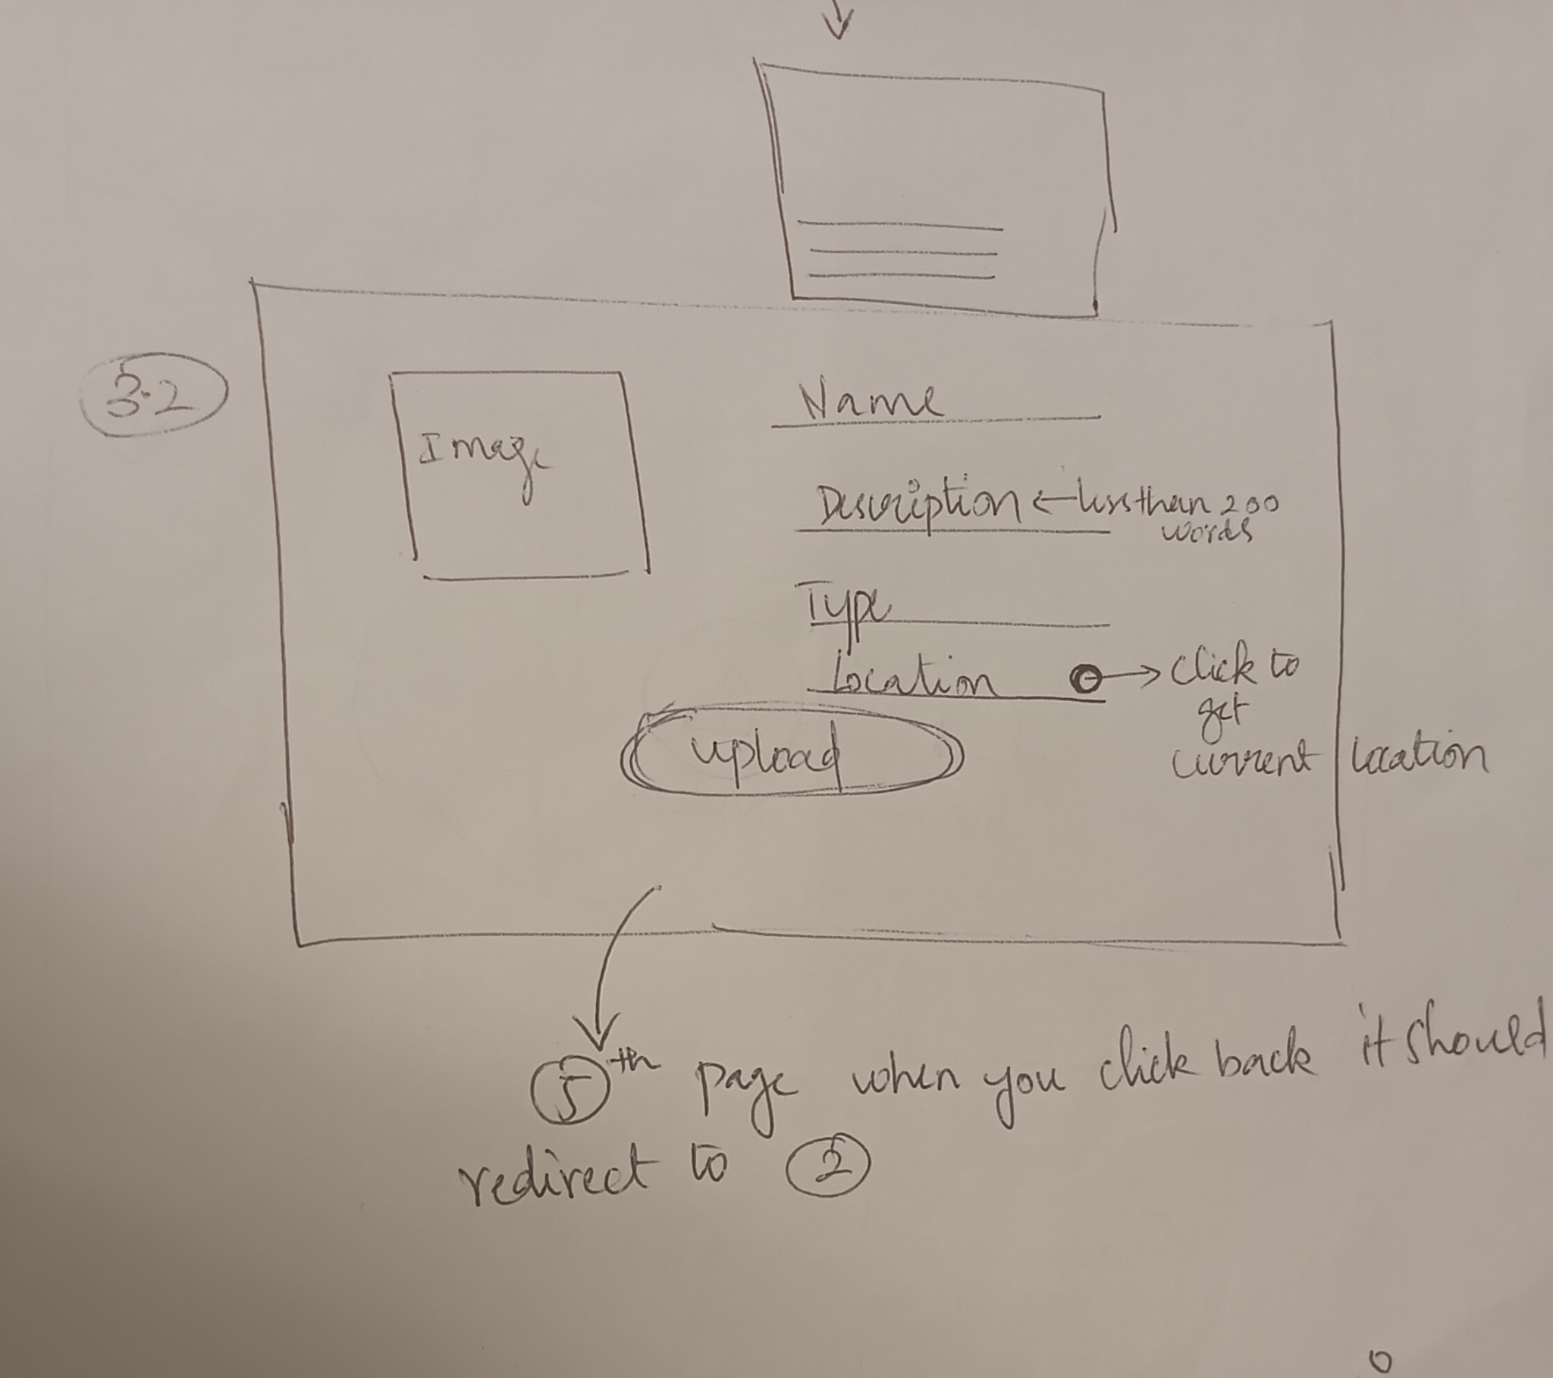
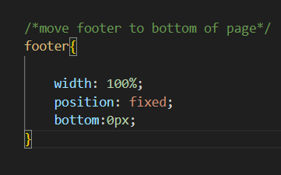
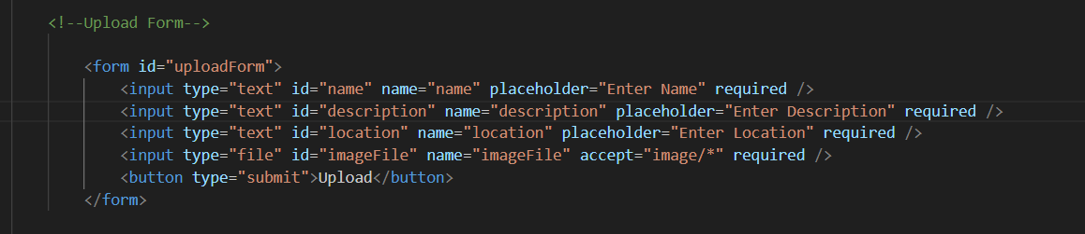
Upload Form Design
Originally going to be a pop-up
CSS footer issues

Slide 8
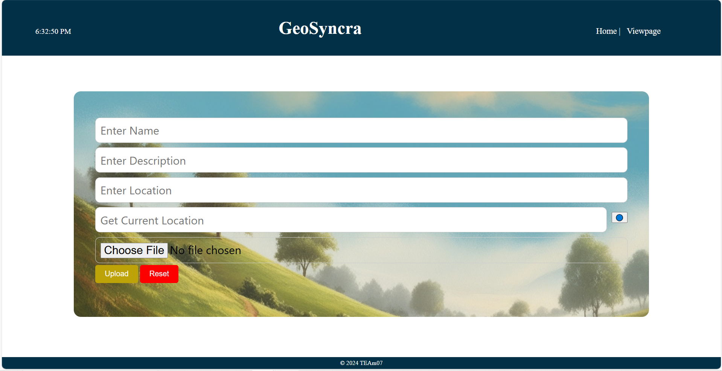
Upload Form Implementation

Slide 9
Backend Development
Gokulnaath Govindaraj

Slide 10
Backend
User Story:
As a user, I want to share my thoughts about the place so that others can also take a look at this place.
Requirements:
The system should allow users to add comments and likes to images.
Users should be able to view the list of comments.
The system must handle both adding and retrieving comments and likes.

Slide 11
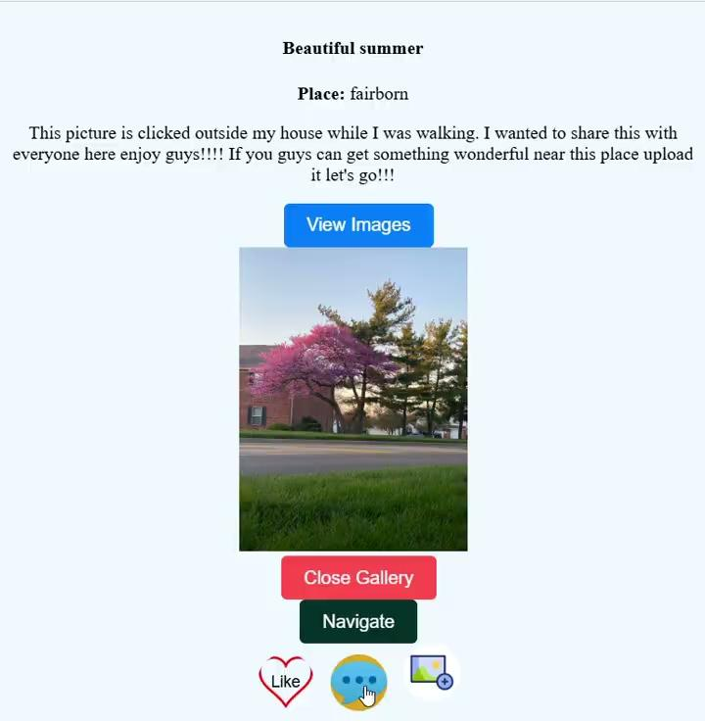
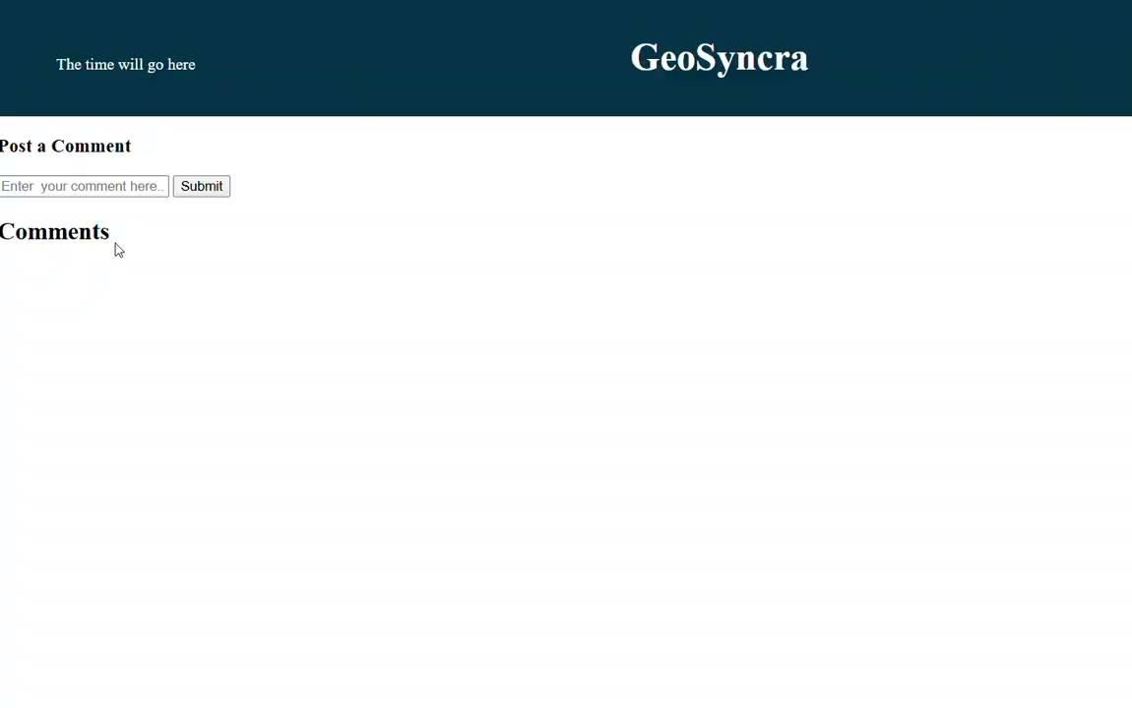
Backend
Design:
Controllers=>This manages incoming HTTP requests for posting and retrieving comments and likes.
POST /{id}/comments: Adds a new comment for the image with the specified ID.
PUT /{id}/like: Updates the likes for the image with the specified ID.
GET /images/{id}/comment: Retrieves the list of comments for the image with the specified ID.
GET /images/{id}/likes: Retrieves the list of likes for the image with the specified ID.

Slide 12
Backend
Design:
Controllers=>This manages incoming HTTP requests for posting and retrieving comments and likes.
Services => This making sure everything gets saved in the database.
Conclusion:
The system supports user interaction with images via comments and likes, improving the overall user experience.
The architecture separates concerns clearly between the controller (handling requests) and service layer (processing business logic), ensuring scalability and maintainability.

Slide 13
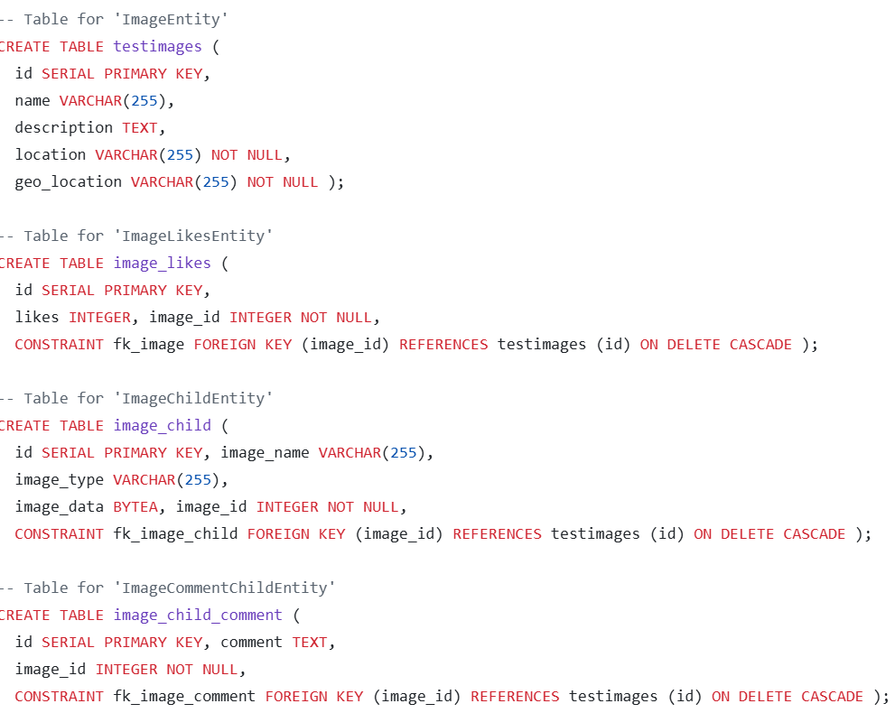
Database Management
User Story: As a user, I want to upload the picture of a location and view directions to the landmark using Google Maps so that I can reach the destination efficiently.
Requirement: The system should accept both image and coordinate input when uploading a location.
The database was designed using Postgresql to store image and location information.

Slide 14
Testing - Prabesh
User Story:
As a user, I want to search for a location on GeoSyncra so that I can quickly find relevant information about it.
Requirements:
The system should allow users to input a location name in the search bar.
Users should be able to initiate the search by clicking the search button.
The system must display relevant results for the searched location.
The search results should be dynamically loaded and clearly visible to the user.
Design:
WebDriver Initialization:
The WebDriver and WebDriverWait are initialized in the @Given step to manage browser automation using FirefoxDriver.
Page Navigation:
The driver.get method navigates to the GeoSyncra homepage (https://geosyncra.netlify.app/) and ensures the page is fully loaded.
Search Functionality:
The search bar (searchBar) is located using By.id("searchBar"), and the user input is passed
using sendKeys(location).
The search button (searchButton) is identified by its ID and clicked using click().

Slide 15

Testing - Prabesh
Results Verification:
The results container (searchResults) is located using wait.until(ExpectedConditions.visibilityOfElementLocated(By.id("searchResults")))
Results are validated using assertTrue, ensuring they contain the searched location.
Browser Management: The browser window is maximized for better visibility, and implicit waits ensure stability. The browser session is closed after the test using driver.quit().
Conclusion:
The search functionality empowers users to efficiently access location-related information, enhancing usability and engagement. The architecture ensures a clear separation of concerns, where controllers manage user interactions and the service layer processes the search logic, promoting scalability
and maintainability.
Test Case:

Slide 16
Deployment
Website
Backend
Database
Netlify
|
Github
Railway
|
Github
Amazon RDS
|
PostgreSQL
The frontend is deployed on Netlify via GitHub for continuous deployment.
This ensures the frontend is automatically updated with the latest changes, streamlining development and maintaining up-to-date user interfaces.
The backend of your application is deployed using GitHub in combination with Railway for continuous deployment
Environment properties for datasource is provided manually here.
Amazon RDS provides a fully managed PostgreSQL database, handling maintenance, backups, and scaling automatically, so you can focus on development without worrying about database management.

Slide 17
Live of GeoSyncra
https://geosyncra.netlify.app/

Slide 18
Conclusion Statement
Overall, we believe the class was quite successful. There were a few challenges along the way, but the class demonstrated remarkable adaptability and provided valuable insight into the computer science job field.

Slide 19
Questions?

